Slide 1

JavaScript Programming
Information Technology
User Input - Validation and Errors

Slide 2


Slide 3
User Input validation
User input captured using prompt is returned are string type
We can convert string values to numeric values using
parseInt
Will convert to integer type. Implicit rounding of integer will occur
parseFloat
Converts to float type

Slide 4
User Input using prompt
<!DOCTYPE html> <html>
<head> <script>
let myIntNumericValue = prompt(“Supply a whole number”);
let myIntNumeric = parseInt(myIntNumericValue); let myFloatNumericValue = prompt(“Supply a decimal number”);
let myFloatNumeric = parseFloat(myFloatNumericValue); let mathOnVariables = myIntNumeric * myFloatNumeric; alert(mathOnVariables); </script> </head> <body>
</body> </html>

Slide 5
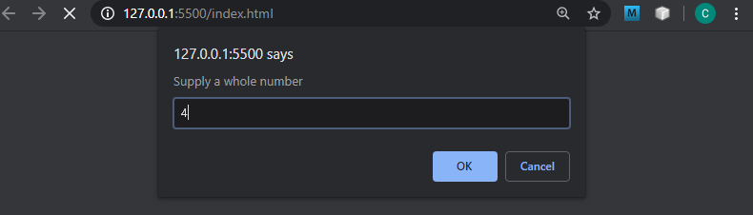

Slide 6
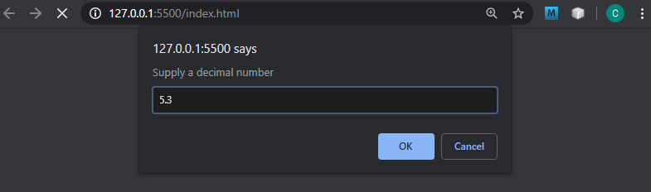

Slide 7
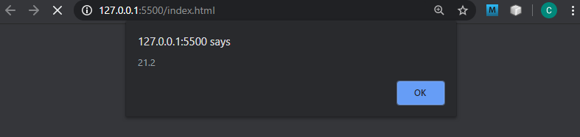

Slide 8
User Input validation
What happens when we introduce alpha characters to parseInt or parseFloat?

Slide 9
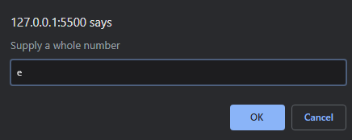
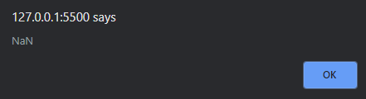
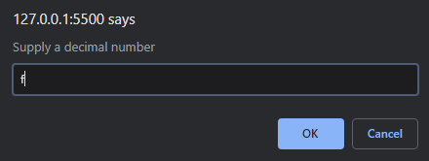
Nan
“Not a Number”

Slide 10
User Input validation
Anytime we attempt to assign a value to a variable using parseInt or parseFloat and the value to convert is not a numeric value, the variable will be assign the value NaN
NaN – Not a number

Slide 11
User Input validation – isNaN method
We can check a variable to see if it is not a number with the method isNaN
Returns a true boolean value if the variable being checked is not a number
Check a variable that is not a numeric
let isNotNumber = isNaN(‘xyz’);
console.log(isNotNumber); //result is true
let isNumber = !isNaN(334);
console.log(isNumber); //result is true
Using isNaN to check for numeric must lead with !
Watch out for double negative

Slide 12
User Input validation – isNaN method
Strings that are all numeric characters can be tested a numeric with !isNaN
let isNumber = !isNaN(‘334’);
console.log(isNumber); //result is true

Slide 13
Try Catch – Runtime Errors
We can catch runtime errors using a try catch block
We can throw an error creating a new Error instance and setting a message
Structure of the Try Catch Finally block
Error object name can be whatever we want
try { statements }
catch (errorName){ statements }
finally { statements }

Slide 14
Try Catch – Runtime Errors
Code that checks if a value is numeric and throws an error that must be caught is the input is not numeric
try {
let myIntNumericValue = prompt('Supply a whole number'); let myIntNumeric = parseInt(myIntNumericValue); if(isNaN(myIntNumeric)){ throw new Error("Error in the value entered"); } alert(myIntNumeric);
} catch (error) { alert(error.message); }
Throw new Error with message as parameter in Error constructor
Access the error message using the Error object message property

Slide 15
